Slide 1
INTRODUCTION to AEROSPACE
Project 3 – Weight Analysis

Slide 2
Project 3 – Weight Analysis
This project consists of two parts. First part includes fuselage interior (cockpit) conceptual design. Second part includes mentioned weight analysis – computing the position of centre of gravity.

Slide 3
Project 3 – Weight Analysis
Cockpit (fuselage interior) project
Cockpit (fuselage interior) project should be done in form of a drawing, that shows arrangement of the aircraft equipment, taking ergonomic rules into account. In order to do that, one can use Sizing guide for cockpits placed on the website. Below, there are three examples of cockpit (fuselage) projects from previous years. These drawings are only an example and should not be used as a sample or template.

Slide 4
Data to fuselage interior sizing
References:
T. C. Corke „Design of Aircraft”
D.P. Raymer „Aircraft Design, a Conceptual Approach”
D. Stinton „The Design of the Aeroplane”

Slide 5
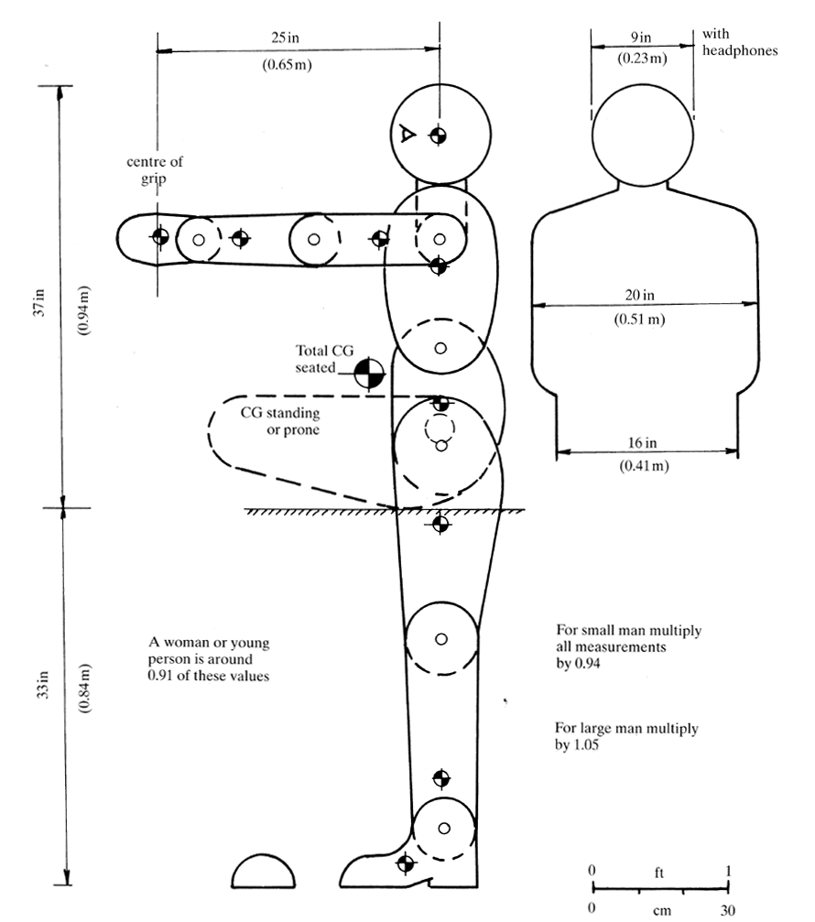
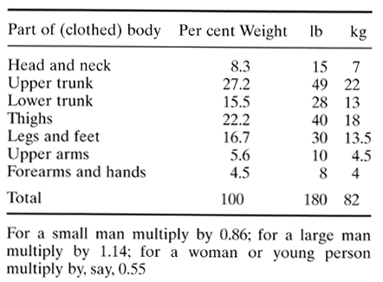
Stinton

Slide 6
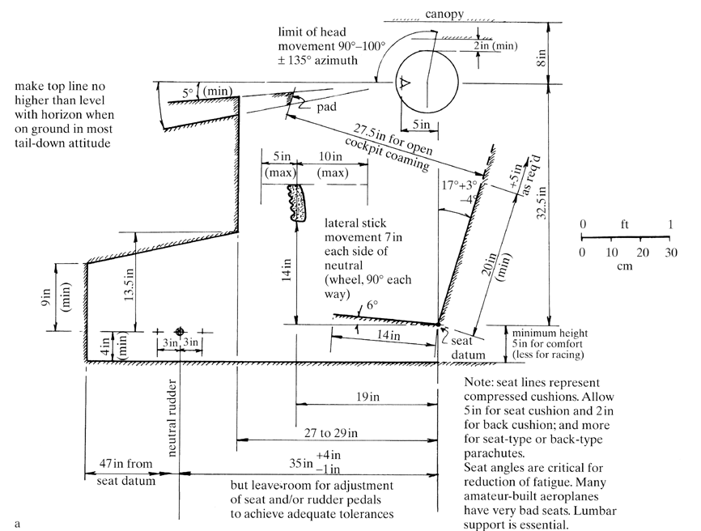
Stinton

Slide 7
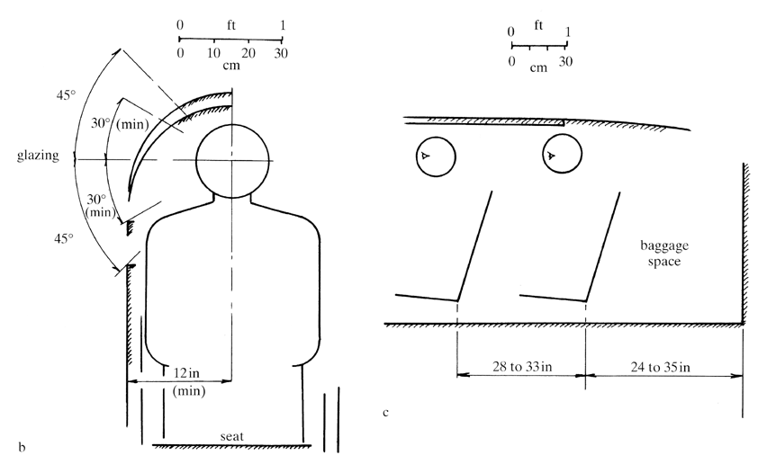
Stinton

Slide 8
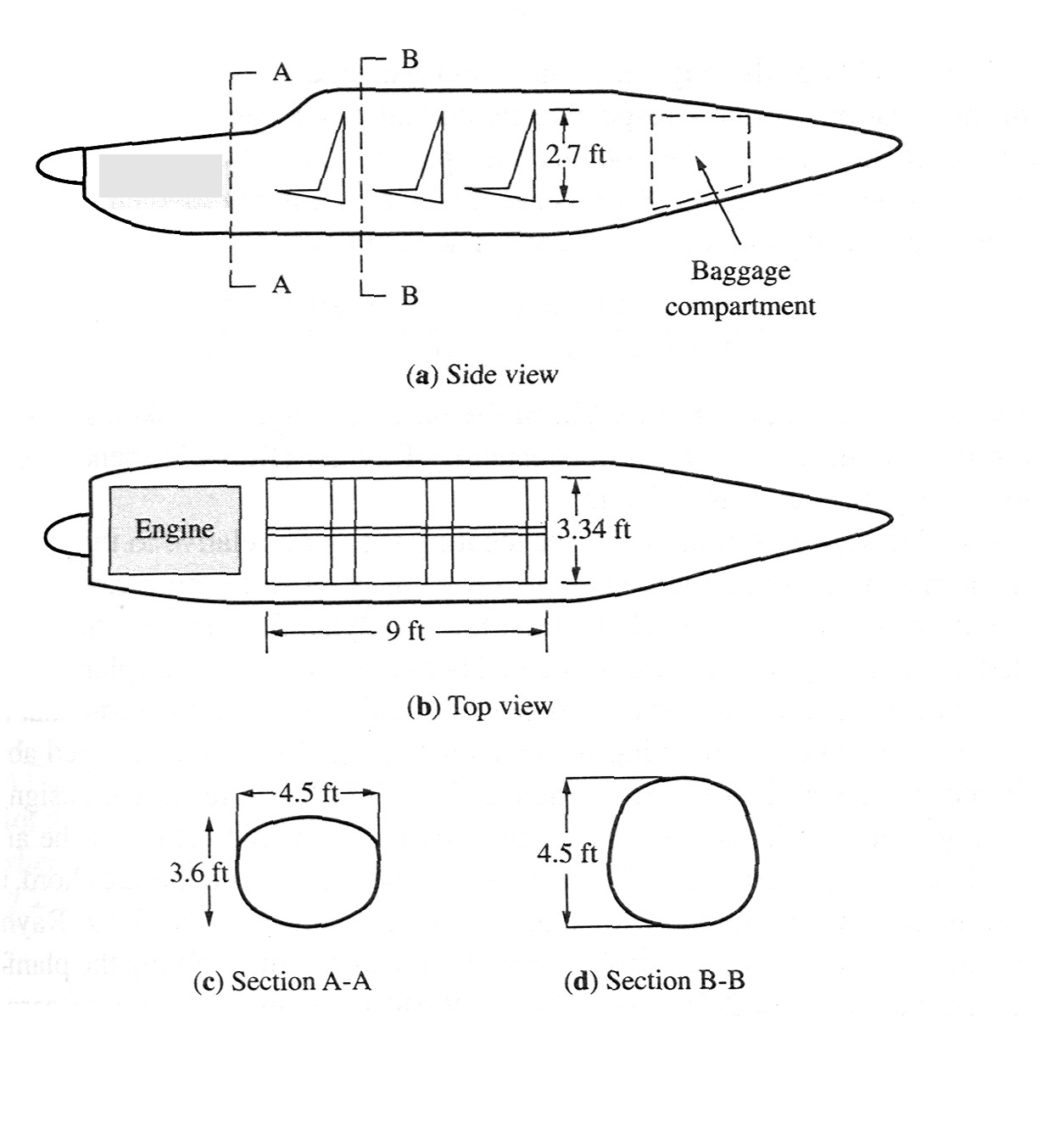

Slide 9
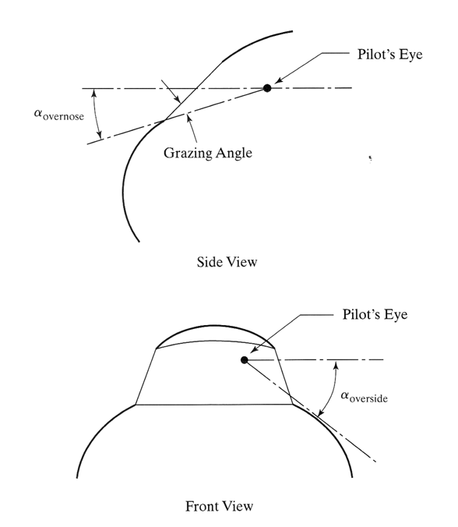
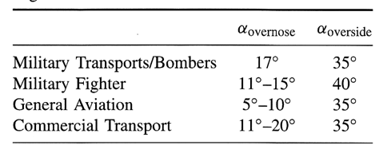
Kryteria kątów widzenia:
Corke

Slide 10
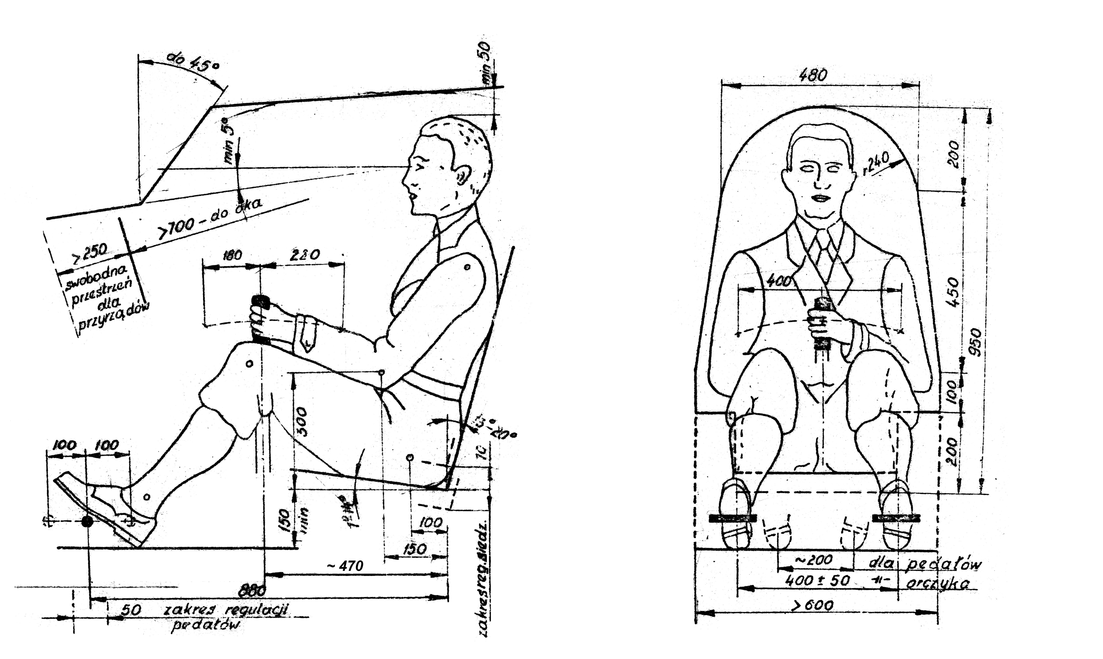
Scheme of single pilot cabin – minimum size requirements

Slide 11
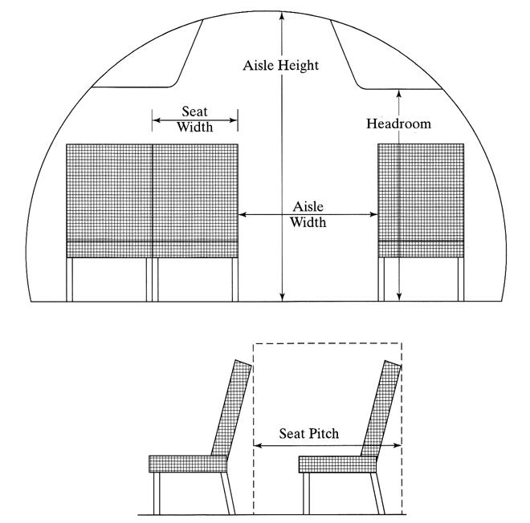
Corke

Slide 12
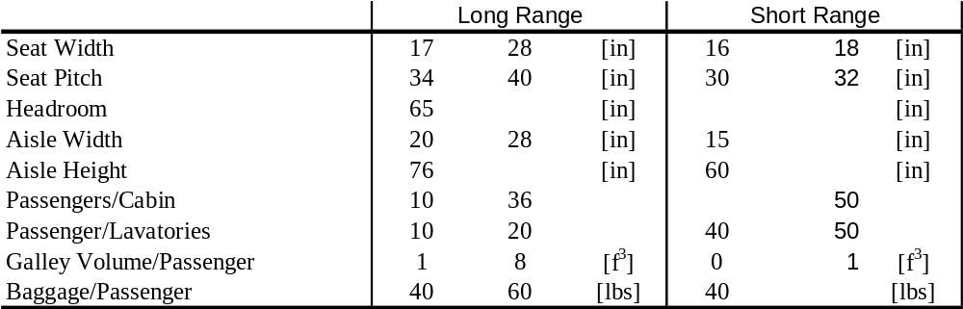
Sizing minimum requirements for passenger cabin

Slide 13
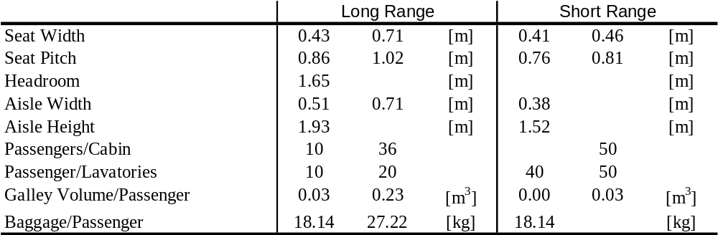
Sizing minimum requirements for passenger cabin (SI units)

Slide 14
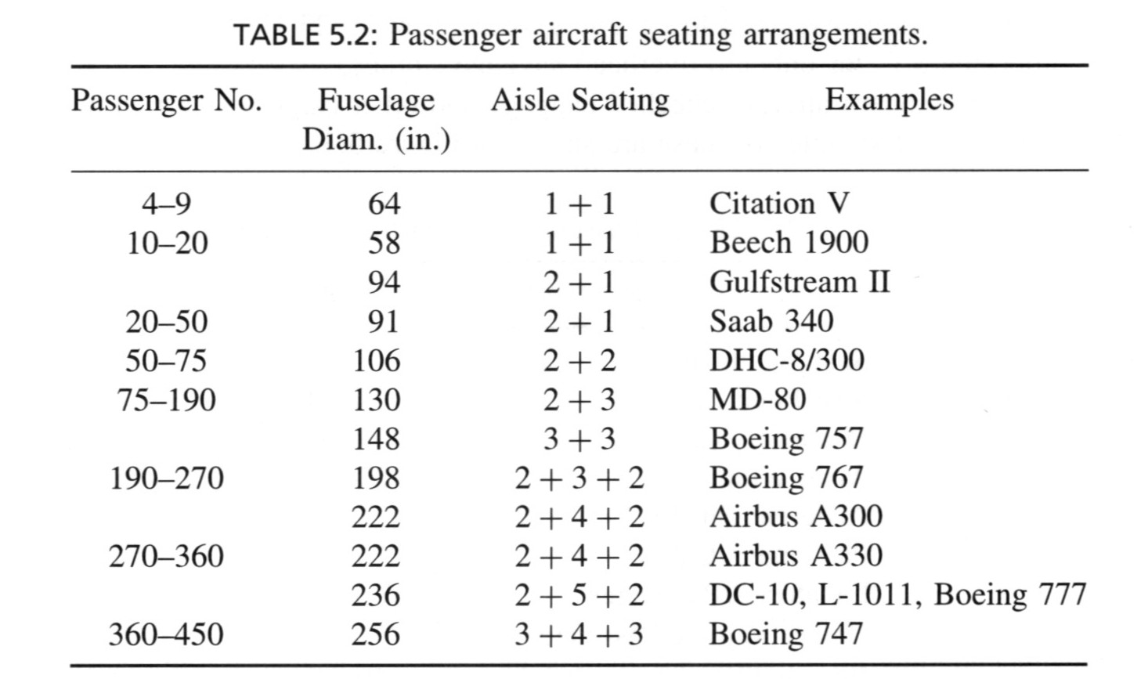

Slide 15
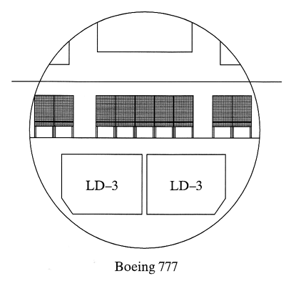
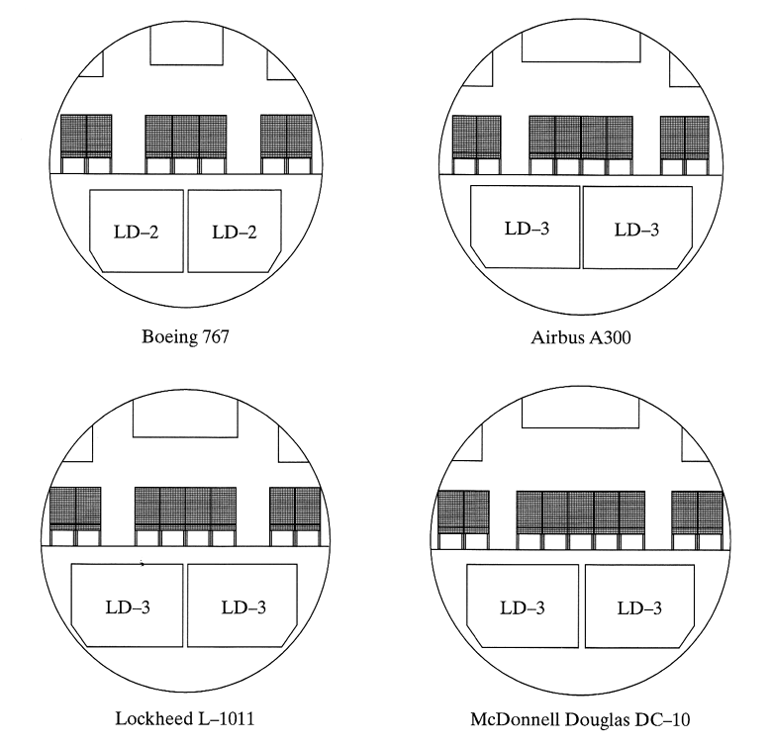
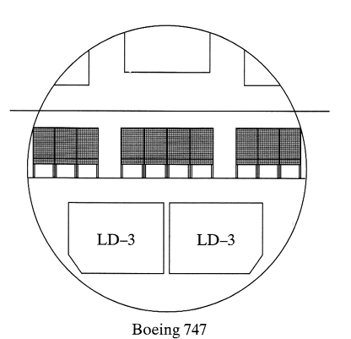
Corke

Slide 16
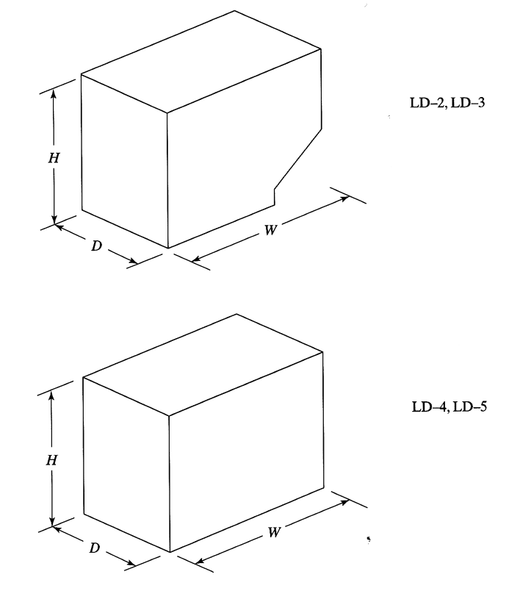
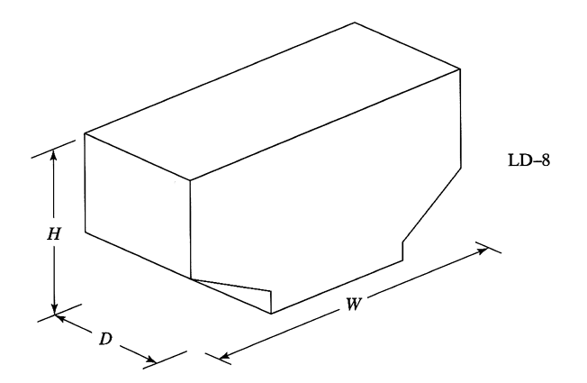
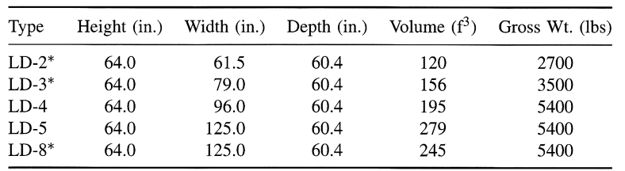
Corke

Slide 17
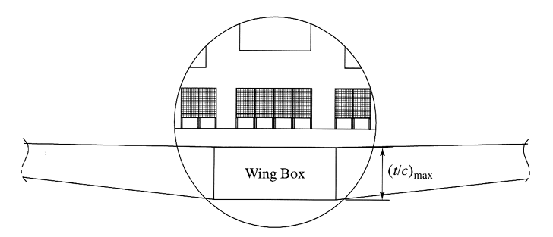
Corke

Slide 18
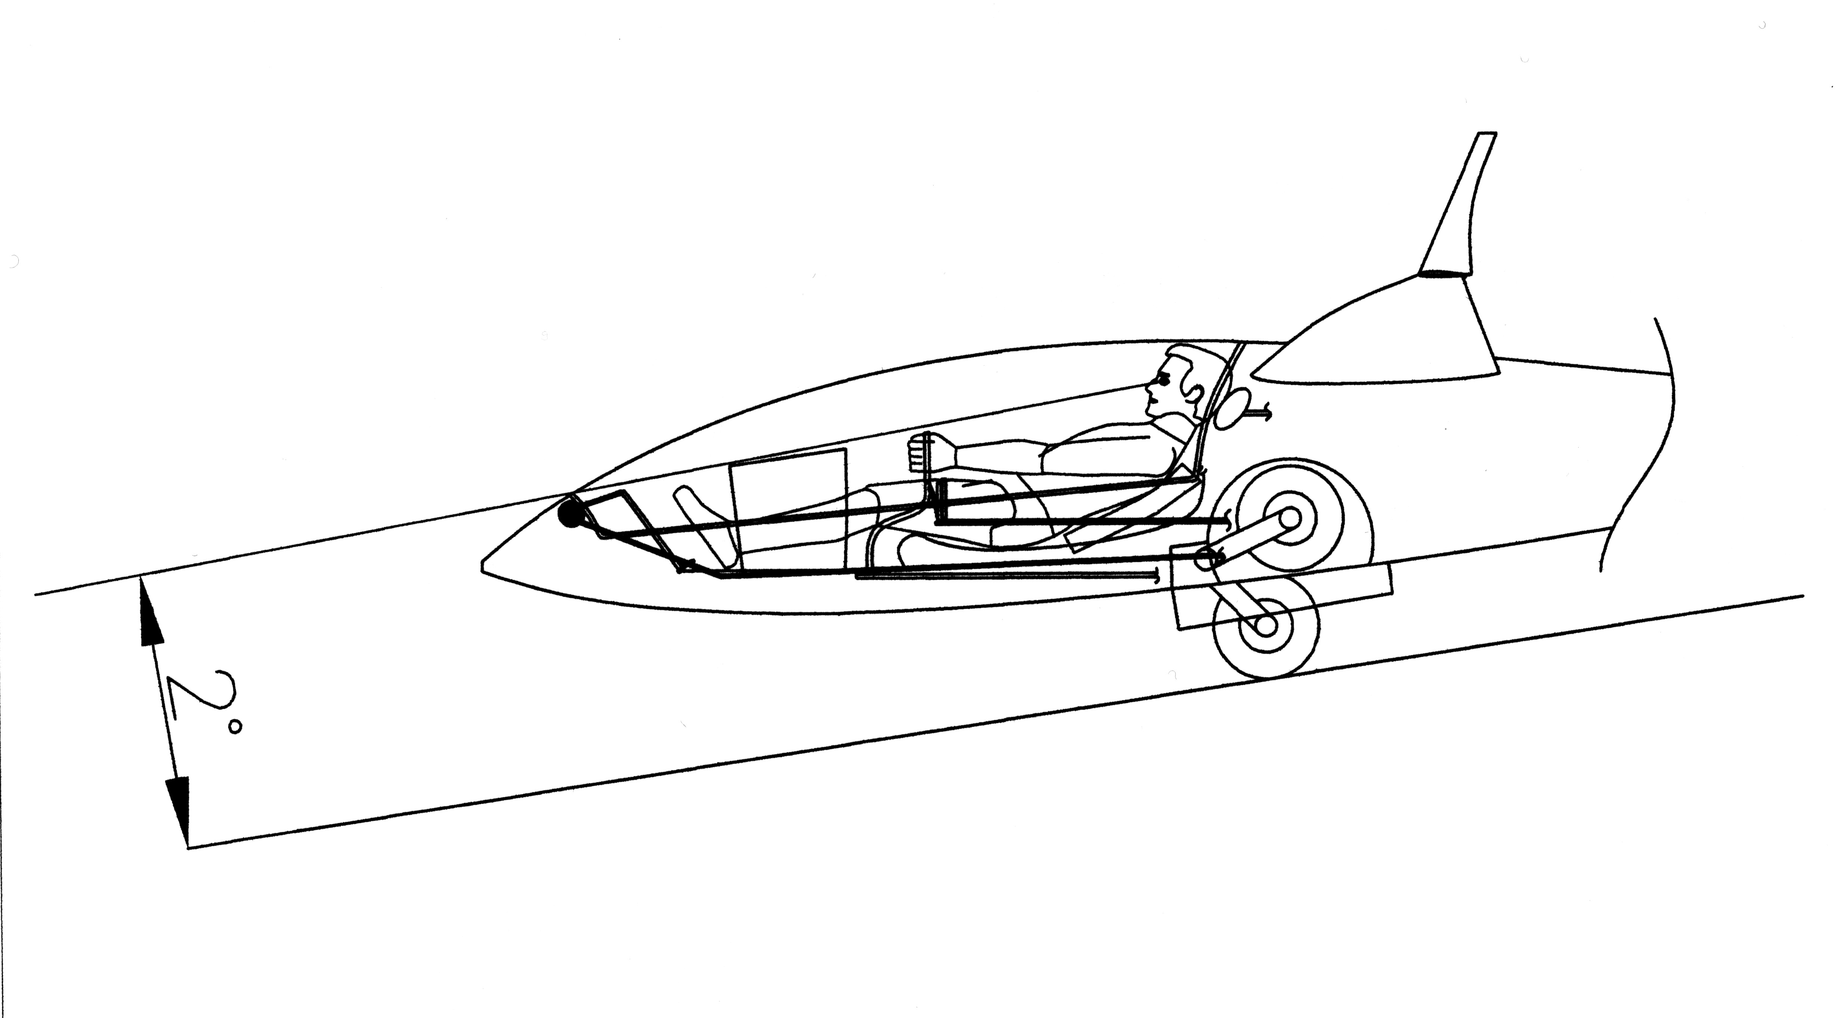
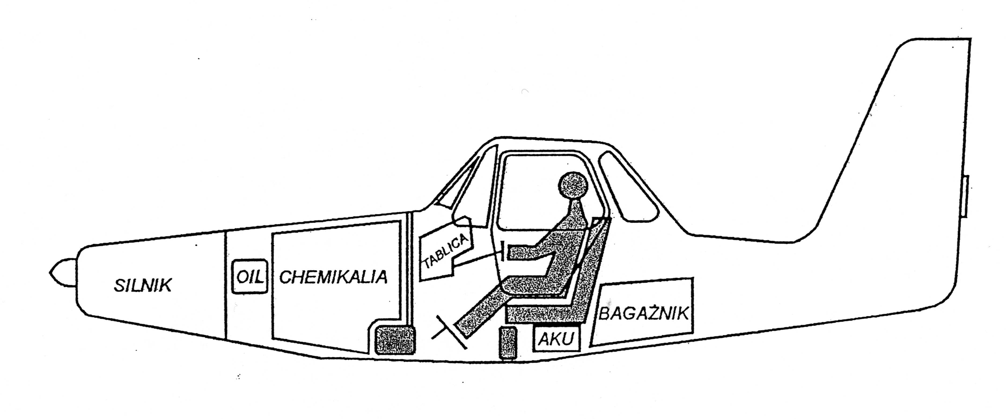
Project 3 – Weight Analysis
examples:
Project of glider’s cockpit
Project of agricultural aircraft’s cockpit

Slide 19
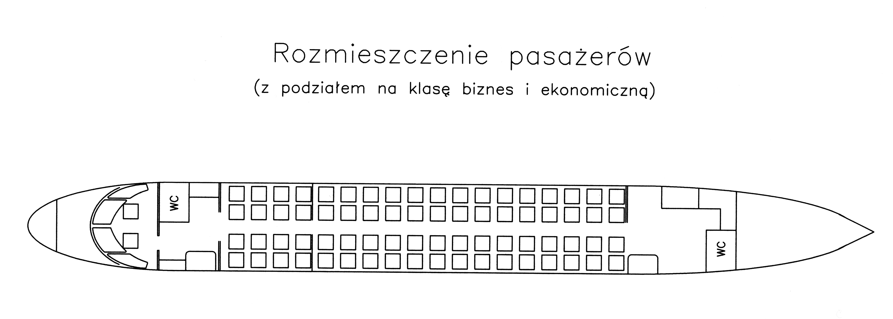
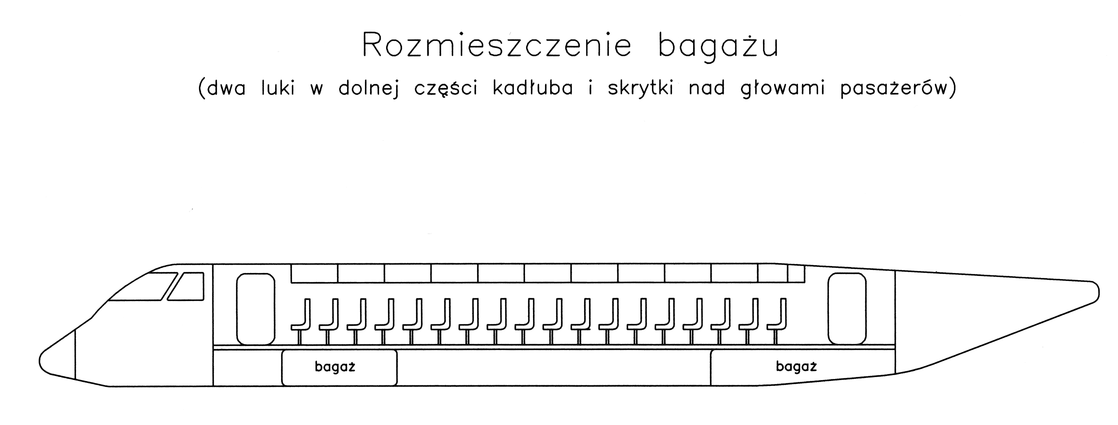
Project 3 – Weight Analysis
examples:
Project of a passenger aircraft’s cabin

Slide 20
Project 3 – Weight Analysis
The weight analysis starts with dividing the aircraft’s body into the components (structure, equipment, payload etc.), and estimating the weight of these components, as well as positions of their centres of gravity. In order to do that, one should make a drawing called a weight breakdown. Next, using suitable relations the position of centre of gravity can be determined and its position can be computed to a scheme related to the mean aerodynamic chord. Component mass data should be presented in a table, and calculations should be done e.g. according to the scheme shown below. Example shown in Table in the next slide shows only a method of presenting results. Number of aircraft’s components taken into consideration should be usually higher.

Slide 21
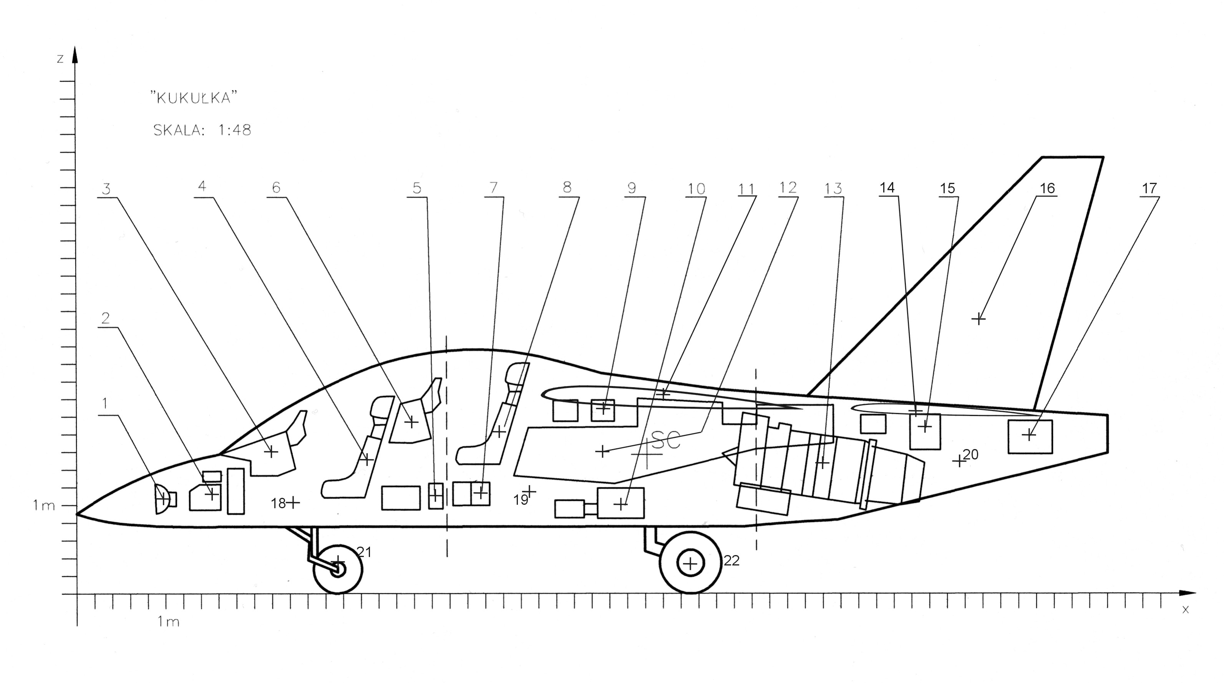
Project 3 – Weights Breakdown
Jet trainer’s weight breakdown example

Slide 22
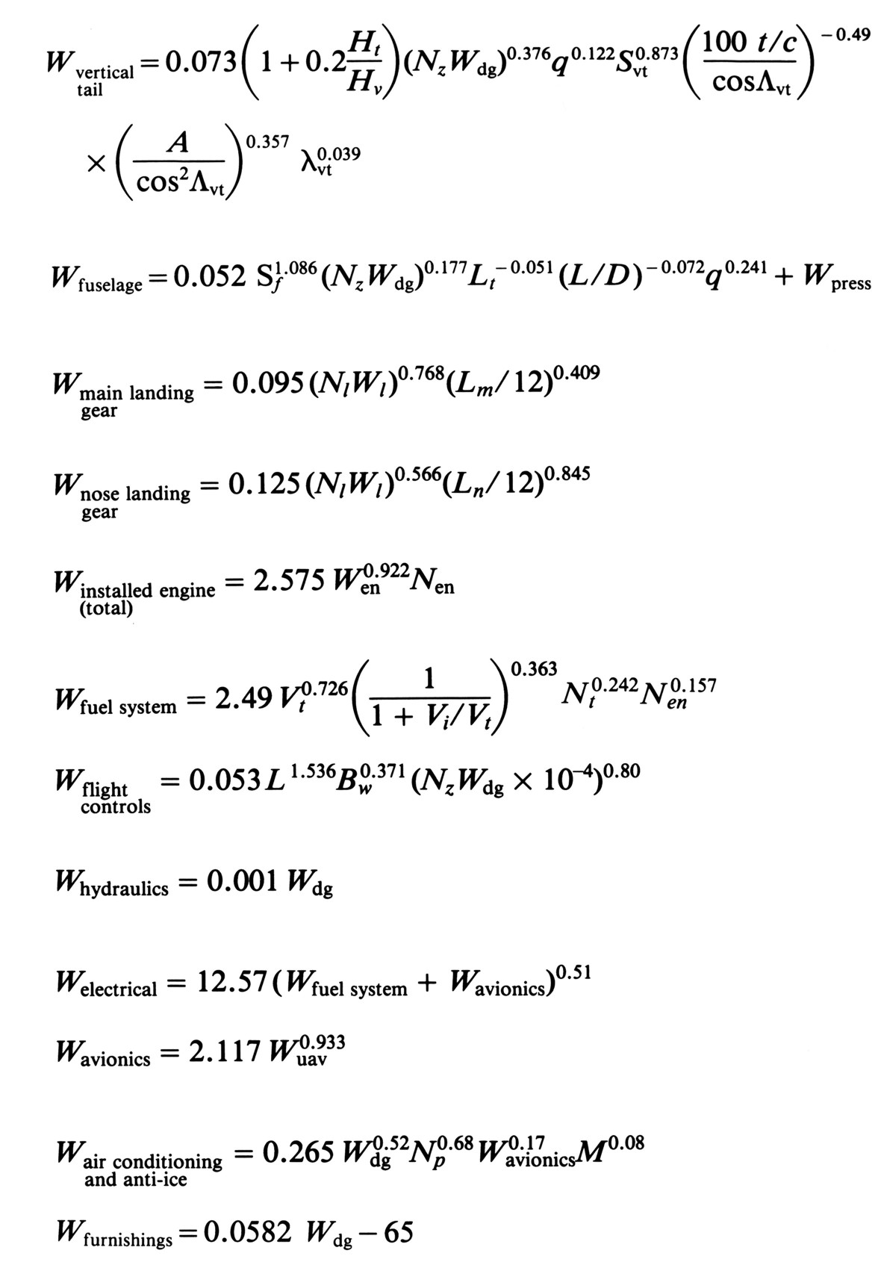
Formulas

Slide 23
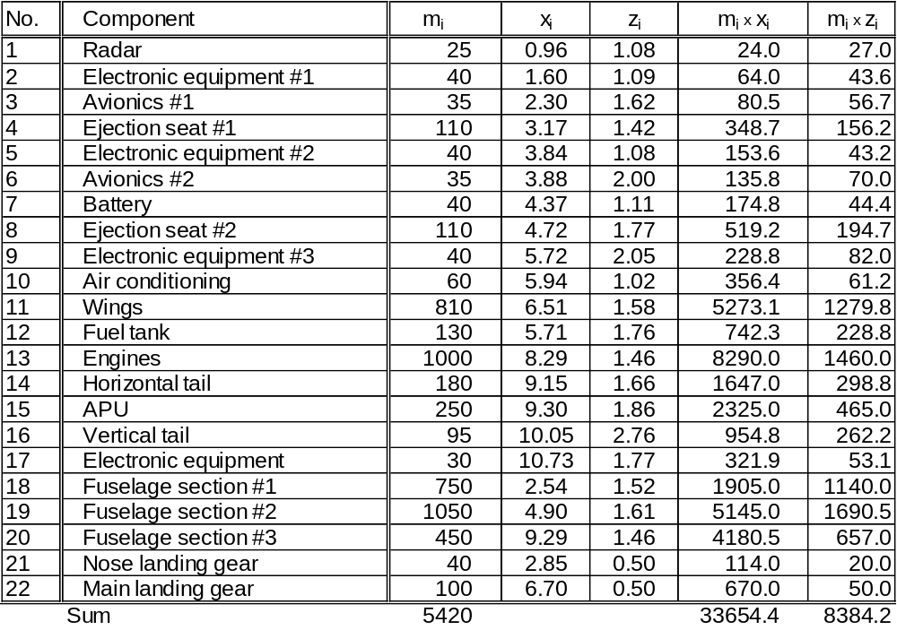
Project 3 – Weights Breakdown
Jet trainer’s weight breakdown example

Slide 24
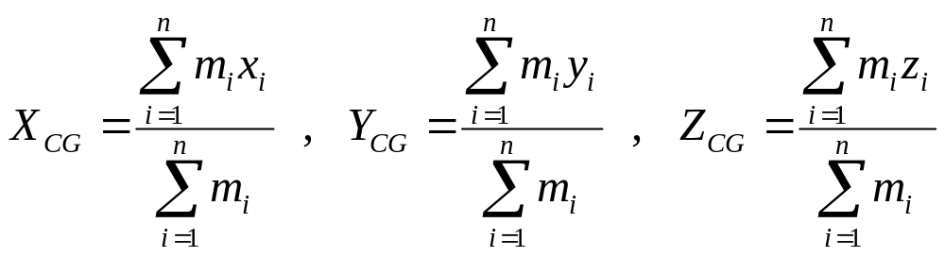
Project 3 – Weight Analysis
Calculations scheme:
Estimation of aircraft’s components weight – calculations and estimations are done based on statistic data and statistic formulas
Loading variants definition
Computing the Mean Aerodynamic Chord and it’s position
Computing CG (centre of gravity) according to formulas:

Slide 25
Project 3 – Weight Analysis
Computing CG position in percent of MAC:
where:
Ca – mean aerodynamic chord (MAC),
X_{A} – position of ¼ of MAC

