Slide 1
INTRODUCTION to AEROSPACE
The History of Aviation
selected pieces I

Slide 2
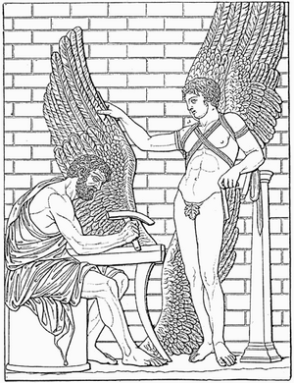
Ancient Mythology – Daedalus & Icarus
Icarus (Greek: Iκαρος, Latin: Íkaros, Etruscan: Vicare) is a character in Greek mythology.
Icarus' father, Daedalus, a talented and remarkable Athenian craftsman, attempted to escape from his exile in the place of Crete, where he and his son were imprisoned at the hands of King Minos, the king for whom he had built the Labyrinth to imprison the Minotaur (half man, half bull). Daedalus, the superior craftsman, was exiled because he gave Minos' daughter, Ariadne, a clew of string in order to help Theseus, the enemy of Minos, survive the Labyrinth and defeat the Minotaur.
Daedalus fashioned two pairs of wings out of wax and feathers for himself and his son.

Slide 3
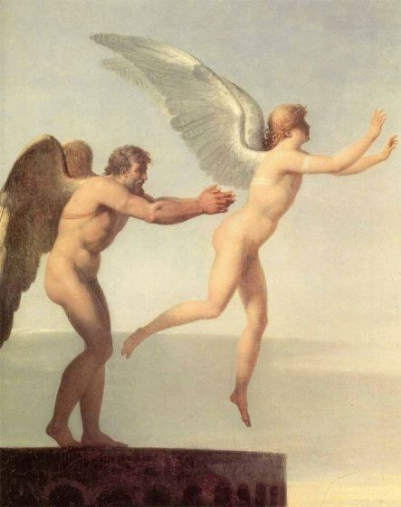
Ancient Mythology – Daedalus & Icarus
Before they took off from the island, Daedalus warned his son not to fly too close to the sun, nor too close to the sea. Overcome by the giddiness that flying lent him, Icarus soared through the sky curiously, but in the process he came too close to the sun, which melted the wax. Icarus kept flapping his wings but soon realized that he had no feathers left and that he was only flapping his bare arms. And so, Icarus fell into the sea in the area which bears his name, the Icarian Sea near Icaria, an island southwest of Samos.

Slide 4
The Aviation History – the Beginnings ?
First notes about “flying people” are from legends of Ancient China from 2200 BC This is the legend about flying emperor Chun.
About 1000 BC brief note about flying people Ki - Kuang. In the same time in ancient India story about flying horse of King Vikramaditya. In ancient Greece the legend about great designer Deadelus and his son Icarus
About 500 BC Chinese Kung - Chutse has built (probably) kite and he has flight by use it.
100 years later Archytas of Tarentum was reputed to have designed and built the first artificial, self-propelled flying device, a bird-shaped model propelled by a jet of what was probably steam. It probably has flown some 200 meters. This machine, which its inventor called The Pigeon, may have been suspended on a wire or pivot for its flight.
150 years later Archimedes of Syracuse discovered the buoyancy formula, known next as Archimedes’ principle.

Slide 5
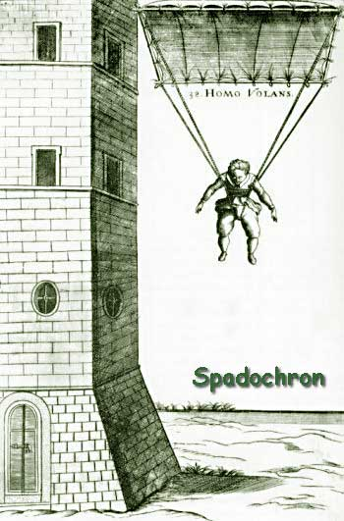
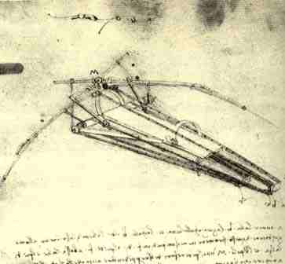
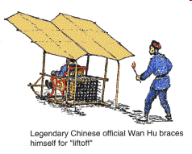
History – the Beginnings
Just about 1500 Leonardo da Vinci has developed his first designs of flying objects: balloons, aircraft, helicopter and parachute. In the same time Chinese Wan Hu has performed the first test flight by use 47 powder rockets – flight has failed
In 1617 first parachute project designed by Fausto Veranzio.

Slide 6
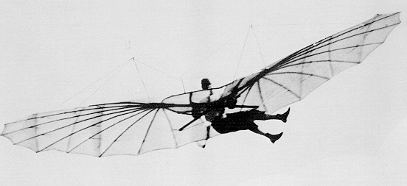
Pioneer’s gliders
Otto Lilienthal’s glider 1894 (National Air and Space Museum)

Slide 7
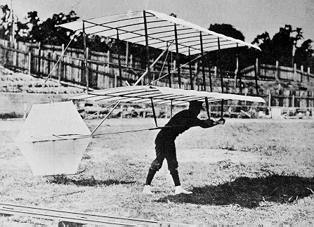
Pioneer’s gliders
Octave Chanute’s glider - 1896 (National Air and Space Museum)

Slide 8
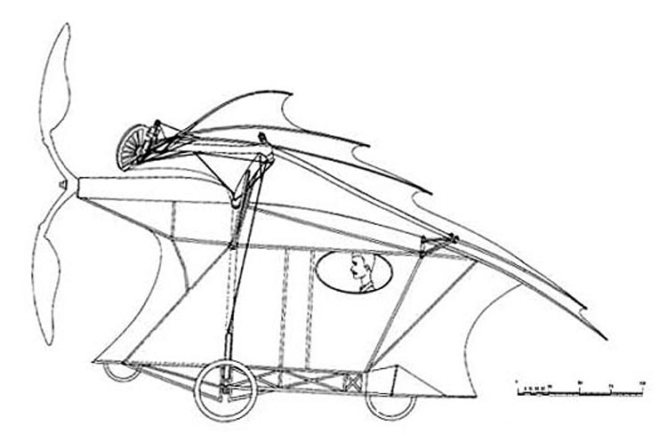
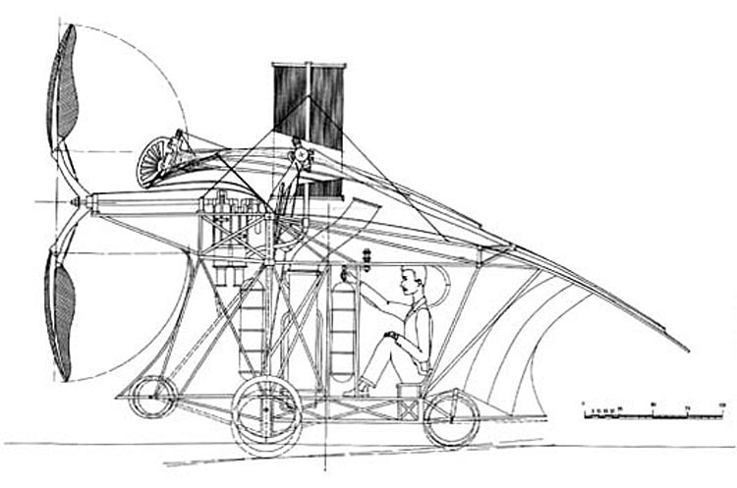
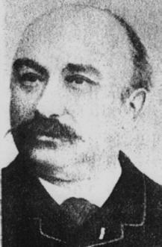
Clement Ader (1841-1926)
Eole (Bat) – first flight 9 X 1890 – 50m ?

Slide 9
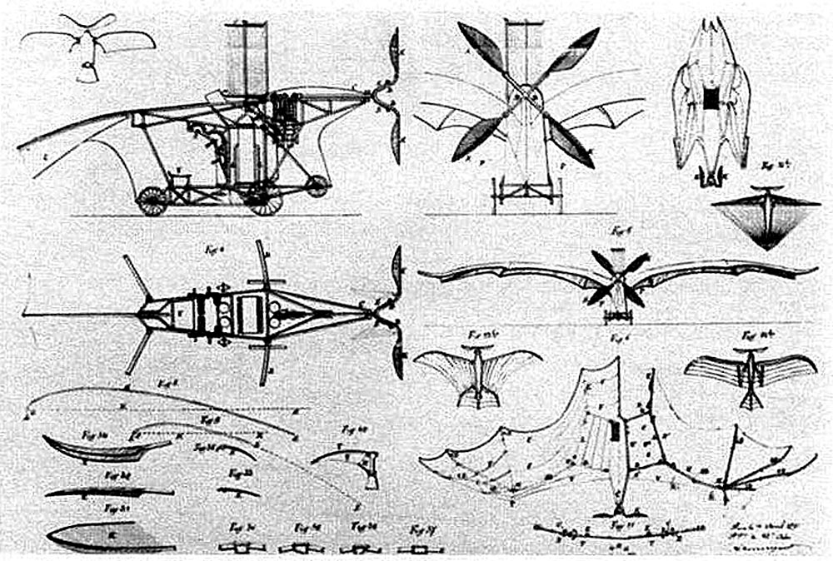
Clement Ader (1841-1926)

Slide 10
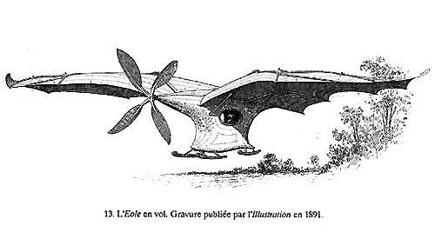
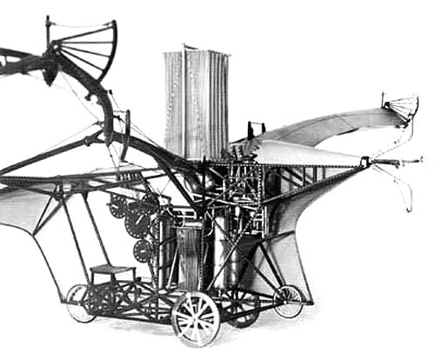
Clement Ader
(1841-1926)
EOLE - 1890

Slide 11
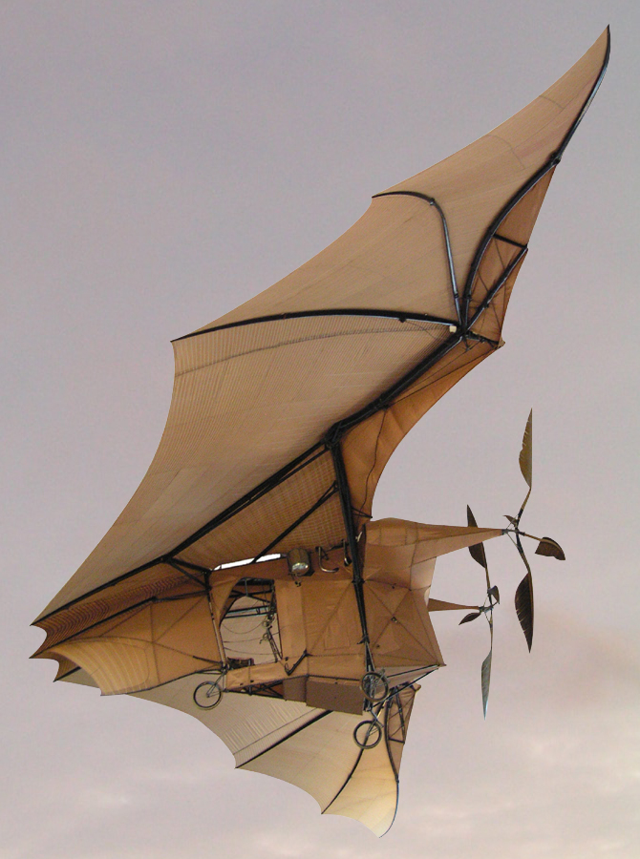
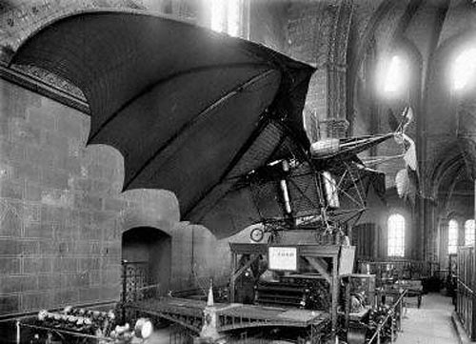
Clement Ader – Avion III
Exhibition – 1895
first (only) flight – 1897 (300m ?)

Slide 12
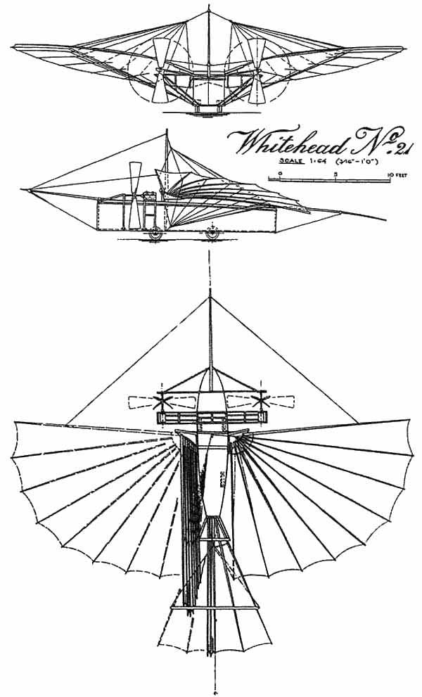
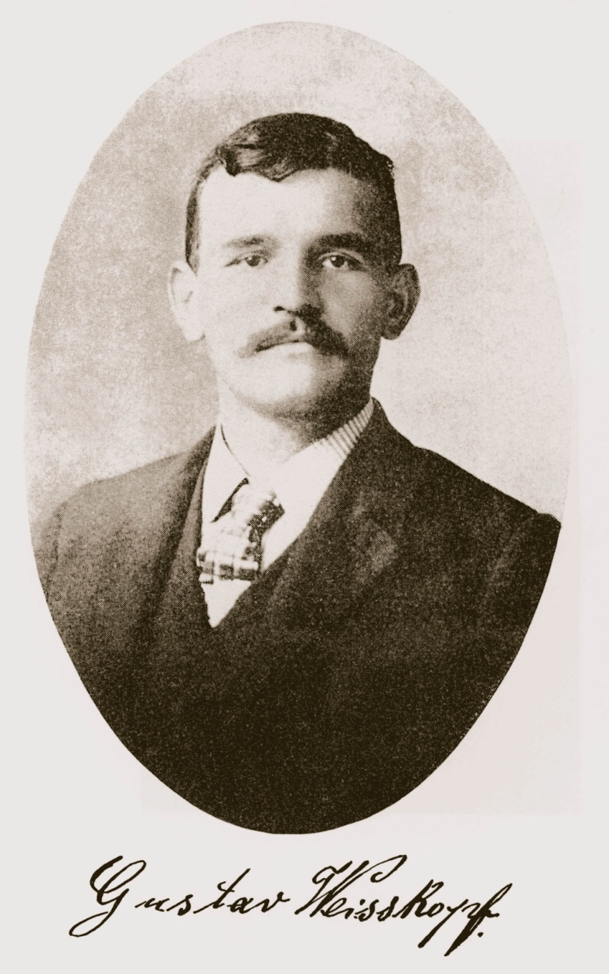
Gustav Whitehead – Weisskopf
(1874-1927)

Slide 13
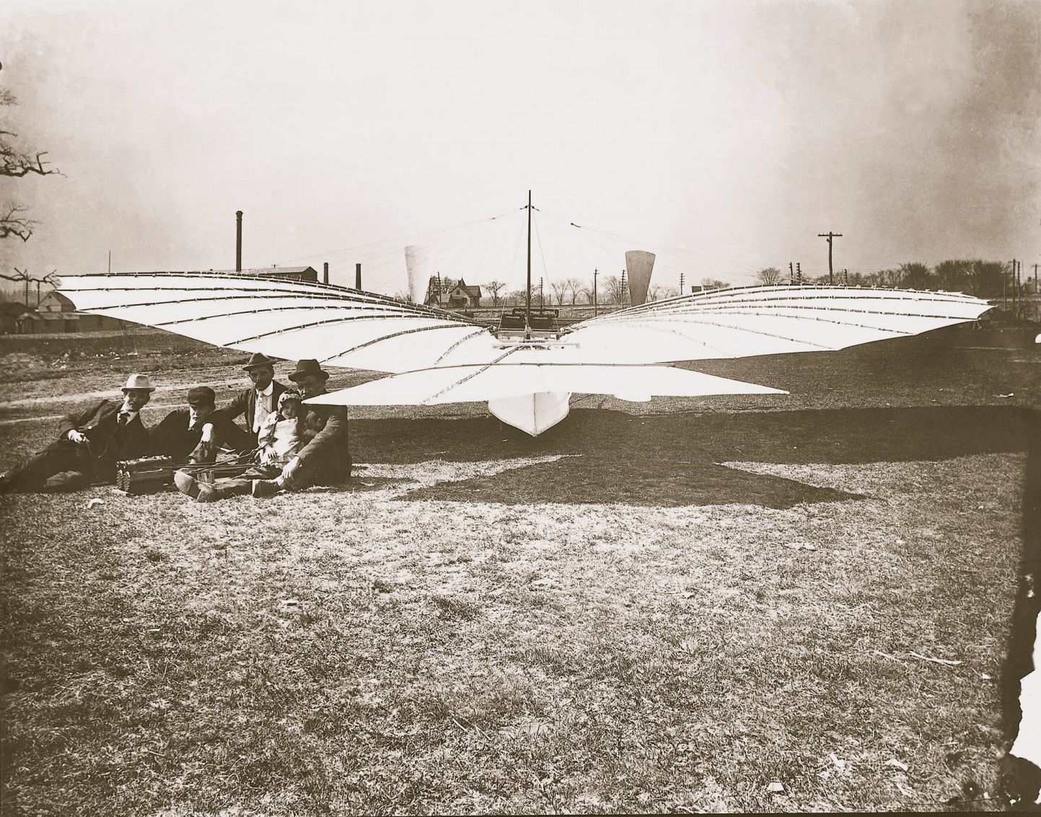
Gustav Whitehead – Weisskopf
(1874-1927)

Slide 14
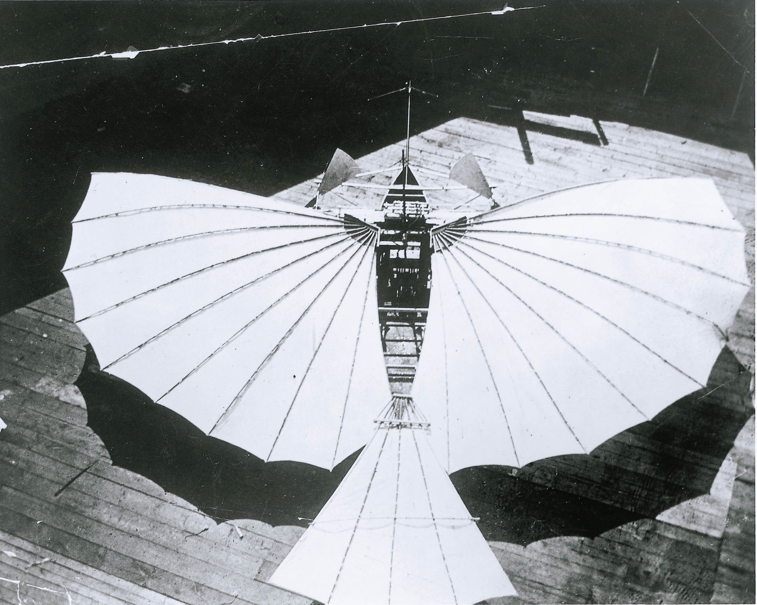
Gustav Whitehead – Weisskopf
(1874-1927)

Slide 15
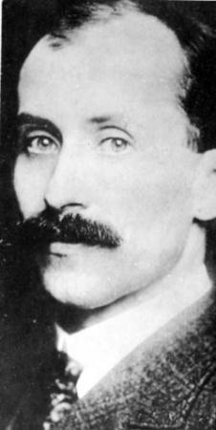
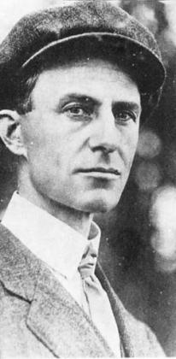
Wright Brothers
Orville Wilbur

Slide 16
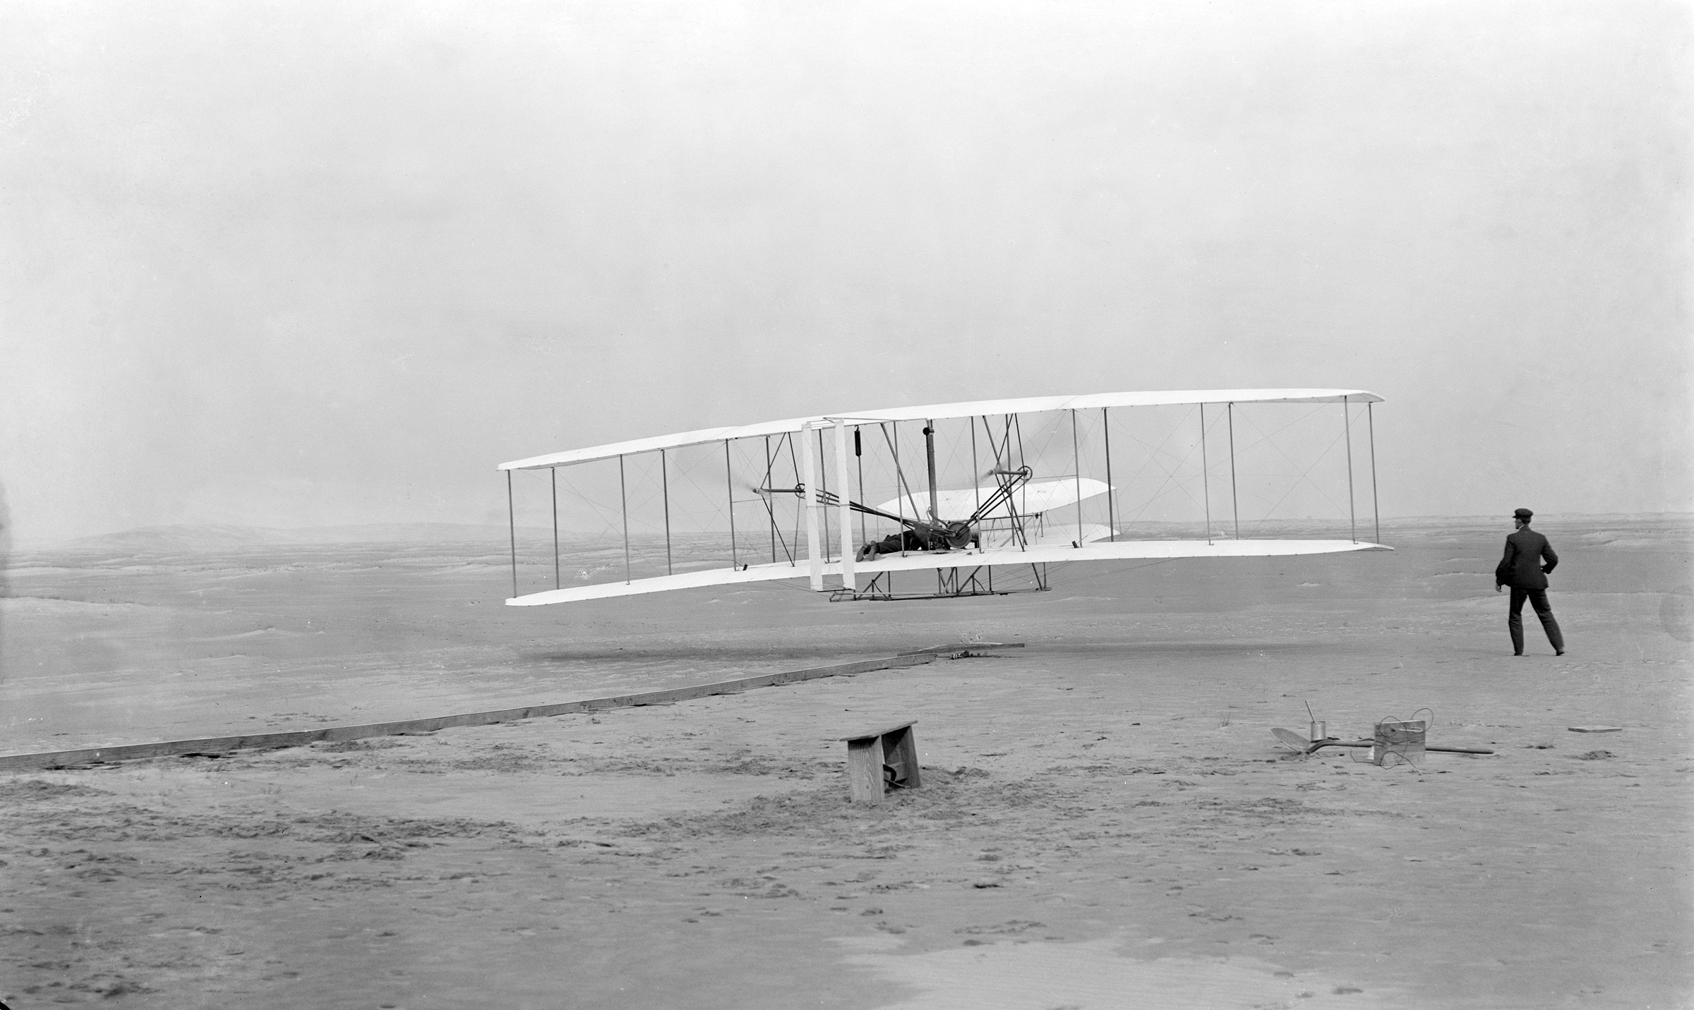
Wright Brothers – first flight:
17 December 1903

Slide 17
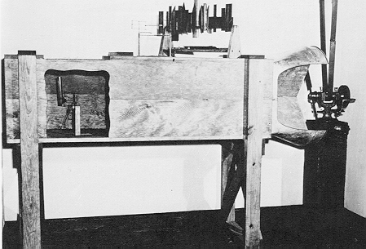
Wright Brothers’ wind tunnel

Slide 18
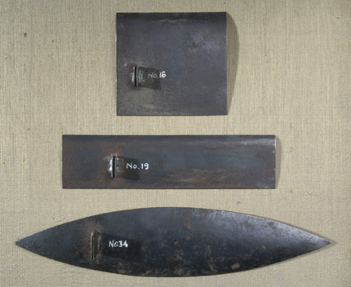
Models for wind tunnel – Wright Brothers

Slide 19
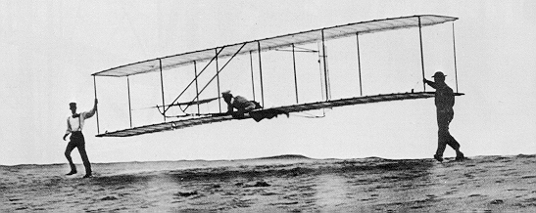
Wright Brothers’ glider - 1902

Slide 20
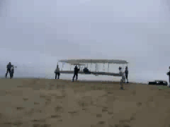
Wright Brothers’ glider - 2003

Slide 21
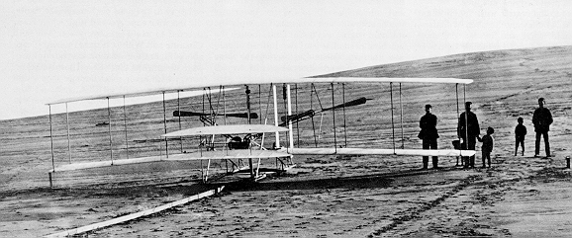
The Wright 1903 Flyer, Ready for a Flight Attempt on December 14, 1903

Slide 22
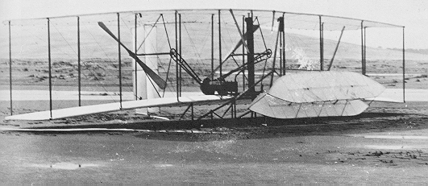
The Wright 1903 Flyer, Damaged After its Fourth Flight on December 17, 1903

Slide 23
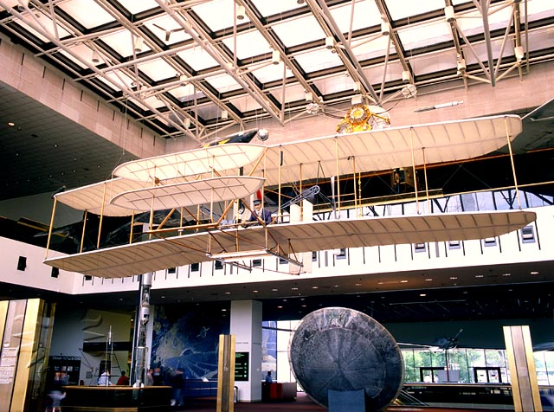
Wright Flyer in museum

Slide 24
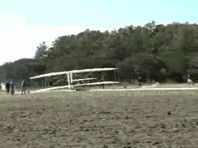
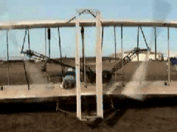
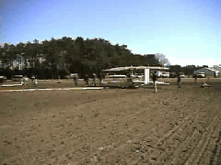
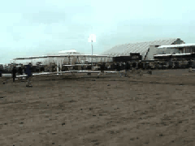

Slide 25
First flight over English Channel
(la Manche)
One of the more famous accomplishment in aeronautics in the pioneer time was the flight over English Channel, from continent to England. It was just performed in 1785 (French Blanchard and American Jeffries). But they made their trip in the opposite direction and using balloon.
In the half of July 1909 three pilots wanted to fly over the channel and have prepared their vehicles: Graf Charles de Lambert on Wright aircraft, Hubert Latham on "Antoinette" and the third – born unfortunate Louis Bleriot on the aircraft designed and built himself – Bleriot IX. His aircraft was equipped with engine, which had a “small” disadvantage – after 20 minutes it was overheated and was not able to work. It allowed to fly by 20-22 km and min width of the English Channell is ca. 38 km, so …

Slide 26
Hubert Latham
Moreover Bleriot had a lot of minor and major accidents before, thus nobody believed, that he can do it. Lambert also was not the main candidate. The favourite candidate was Hubert Latham. On 19 July Latham took off from Cap Blanc Nez, near Sangatte, but after only eight miles the Antoinette IV suffered engine failure and Latham had to perform the world's first landing of an aircraft on the sea. The undamaged fuselage remained afloat so he lit a cigarette and awaited rescue by the French torpedo-destroyer Harpon that was following.
However Latham didn’t wake up and he decided to start again at 25 July

Slide 27
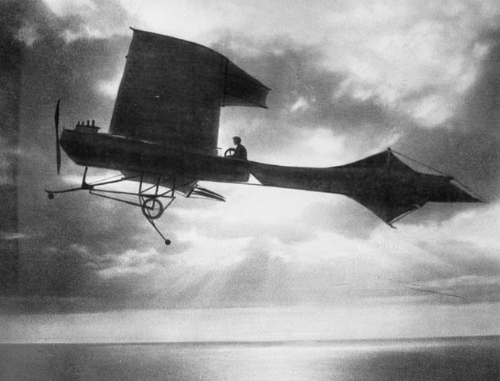
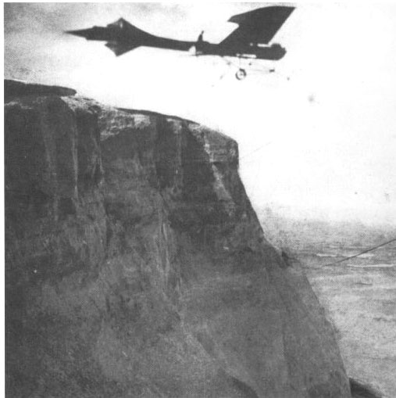
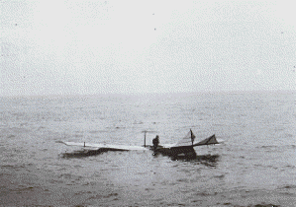
Hubert Latham – 19 July 1909

Slide 28
Louis Bleriot
However Louis Bleriot got the jump Latham.
He took of in the morning, despite the bad weather, which in consequence was very helpful for him. After 20 minutes of flight, when engine was close to overheat it began to rain and the rain cooled the engine. After 38 minutes he landed in England. The landing severely damaged his landing gear, along with the propeller. However, the rest of the aeroplane was in good order and the landing was deemed successful.
Latham took of, despite ha just knew, that Bleriot was the first – he wanted to be the second. Unfortunately he failed again just 1km from England shore.

Slide 29
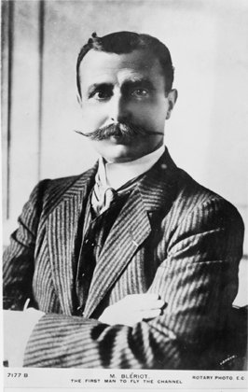
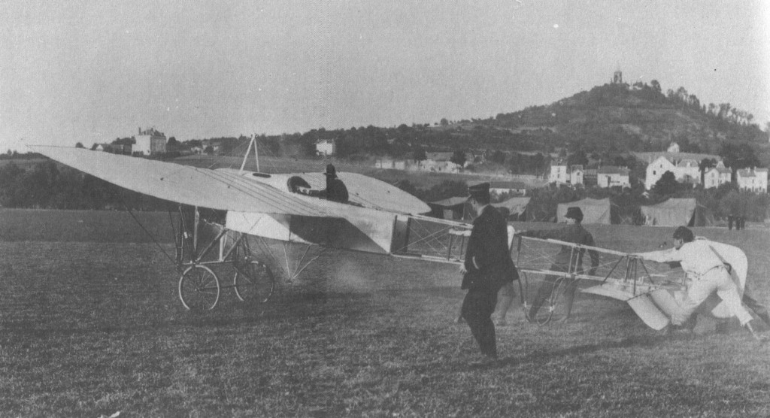
Louis Bleriot

Slide 30
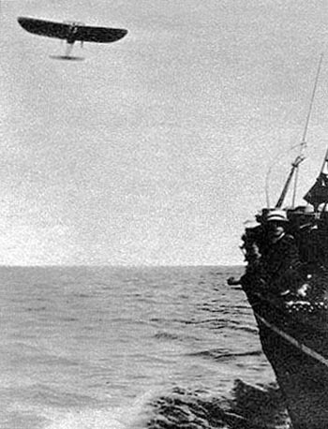
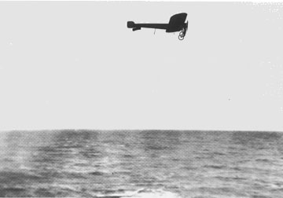
Louis Bleriot

Slide 31
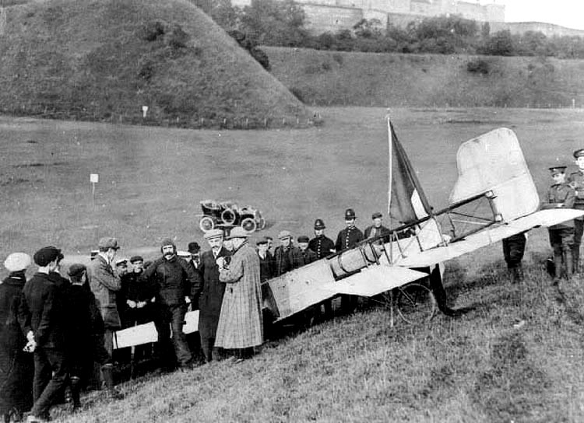
Louis Bleriot

Slide 32
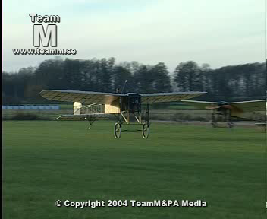
Louis Bleriot

Slide 33
Other pioneer accomplishments
1910 - Geo Chavez has flown over Alps and performed the ceiling word record - 2587 m,
1913 - Roland Garros has flown over Mediterranean Sea - distance 760km
25 February 1914, Ilia Muromiec took off for its first demonstration flight with 16 passengers aboard.
1913 - Piotr Niestierow performed the first loop and French Adolphe Pegoud other aerobatic manoeuvres: roll, spin,
1914 - Jan Nagórski has done first flights in arctic area.

Slide 34
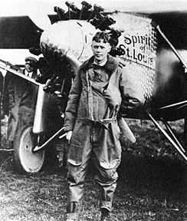
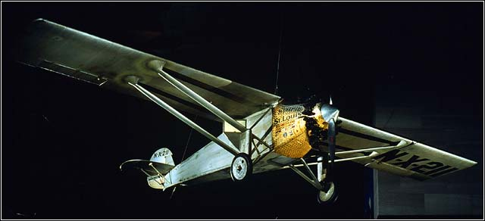
Charles Lindberg 1927

Slide 35
Charles Augustus Lindbergh
(February 4, 1902 – August 26, 1974)
(nicknamed "Slim" , "Lucky Lindy" and "The Lone Eagle")
One of the American pioneer famous due to the first single non-stop flight (33 ½ hours) across Atlantic Ocean, from North America to Europe in 1927.
Charles Lindbergh was also one of the pioneer of aero-archaeology. In February 1929, during flight over Jungle on Yucatan peninsula, he noticed the Mays city ruins. This discovery causes the interesting in searching of ancient buildings, cities from the air. In August 1929 Lindbergh performed the flight above Arizona and New Mexico, discovering many places of Pueblo culture, including unknown towns built in rocks.

Slide 36
Other great flights – Vickers Vimy
The most significant was the first non-stop crossing of the Atlantic Ocean by Alcock and Brown in June 1919 (their aircraft is preserved in the London Science Museum);
In 1919, the Australian government offered £10,000 for the first All-Australian crew to fly an aeroplane from England to Australia. Keith Macpherson Smith, Ross Macpherson Smith and two other men completed the journey in Darwin on 10 December 1919 (their aircraft G-EAOU is preserved in a museum in Smith's hometown Adelaide, Australia);

Slide 37
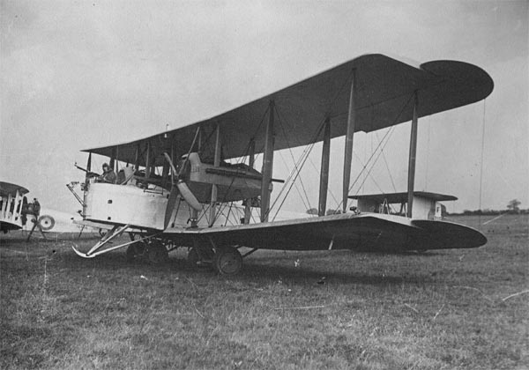
Vickers Vimy

Slide 38
Vickers Vimy
In 1920, Lieutenant Colonel Pierre van Ryneveld and Major Quintin Brand attempted to make the first England to South Africa flight. They left Brooklands on 4 February 1920 in the Vimy G-UABA named Silver Queen. They landed safely at Heliopolis, but as they continued the flight to Wadi Halfa they were forced to land due to engine overheating with 80 mi (130 km) still to go. A second Vimy was loaned to the pair by the RAF at Heliopolis (and named Silver Queen II). This second aircraft continued to Bulawayo in Southern Rhodesia where it was badly damaged when it failed to take off. Rynevald and Brand then borrowed a Airco DH.9 to continue the journey to Cape Town. They were disqualified as winners but nevertheless the South African government awarded them £5,000 each.

Slide 39
Progress in Aviation
Historical perspective
Faster, higher, further - interpretation of progress in the early decades of aviation
Better, Faster, Cheaper - the main trend since the second World War to the 90s
Cleaner, Quieter, Greener – new directions in the last decades

Slide 40
Forecasting the development is very risky
1895 - Lord Kelvin: Heavier-than-air flying machines are impossible.
1900 - Lord Kelvin: I have not the smallest molecule of faith in aerial navigation other than ballooning or of expectation of good results from any of the trials we hear of
1902 – Simon Newcomb: Flight by machines heavier than air is unpractical and insignificant, if not utterly impossible.
1910 - We do not consider that aeroplanes will be of any possible use for war purposes. (The British Secretary of State for War)

Slide 41
What is the source of the progress?
The man’s craze
  wars
  desire to be first (racing, records, etc.)
comfort – airplane is comfortable and fast vehicle
A great challenges, visions

Slide 42
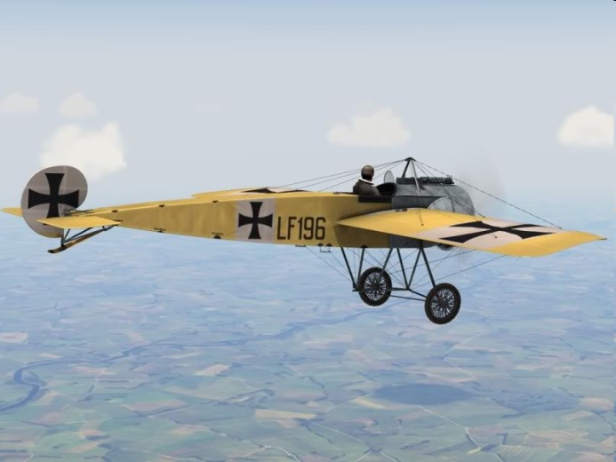
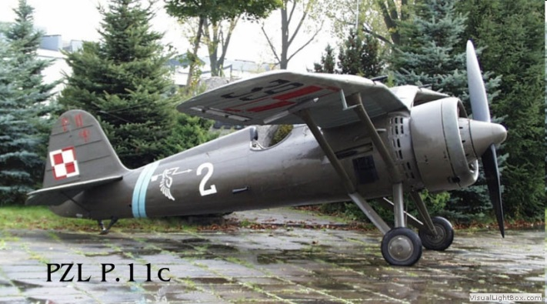
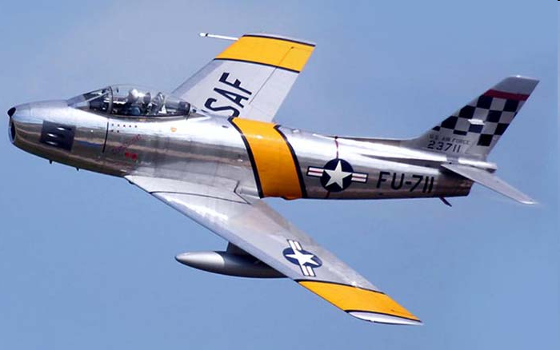
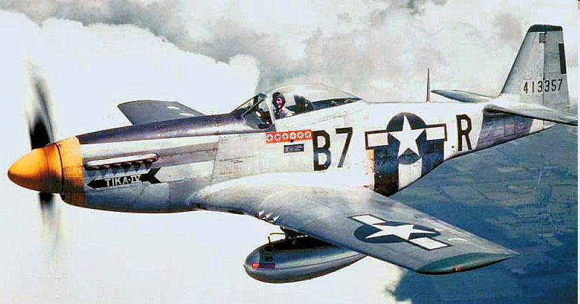
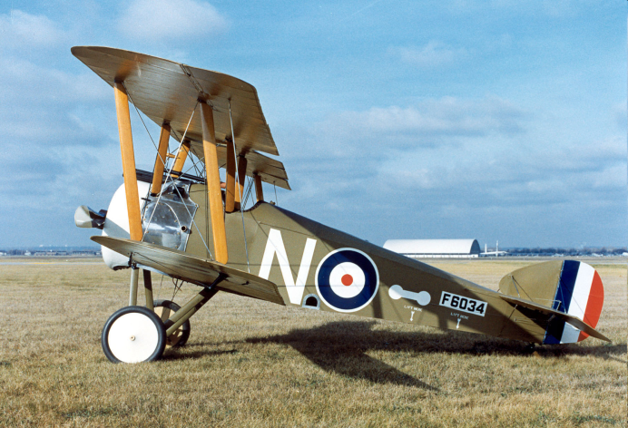





Wars – WW 1, WW 2, Cold war
25 years
80 years

Slide 43


Wars – WW 1, WW 2, Cold war

Slide 44


Wars – WW 1, WW 2, Cold war

Slide 45

Races and rallies
Schneider’s Trophy
Challenge Rally
American races:
  American National Air Races
  Thompson’s Cup
  Bendix’s Cup
  other (e.g. Free for All Races)

Slide 46

Schneider’s Cup Winner in 1913 - Deperdussin

Slide 47

Schneider’s Cup Winner in 1931 – Supermarine S-6B

Slide 48

Schneider Trophy – races of hydroplanes

Slide 49

Schneider Trophy – Max airspeed

Slide 50

Schneider Trophy – Engine power

Slide 51
What left ?
new types of aircrafts
progress in aerodynamics
progress in structure design
new engines
...

Slide 52

grid structure

Slide 53

Monocoque and Semimoncoque structure

Slide 54

1912 – first aircraft of Monocoque fuselage structure - Deperdussin

Slide 55

1912 – first aircraft of Monocoque fuselage structure - Deperdussin

Slide 56

1912 – first aircraft of Monocoque fuselage structure - Deperdussin

Slide 57

1912 – first aircraft of Monocoque fuselage structure - Deperdussin

Slide 58

The fuselage of Locheed Aircraft's S-1, designed by Jack Northrop,
was molded plywood.

Slide 59

Concrete mold in which monocoque wooden shell of the S-1 Lockheed
sport biplane of 1919 was formed.

Slide 60


New technologies transfer …
Supermarine S6B (1931) → Spitfire (1936-48)

Slide 61


New technologies transfer …
Macchi MC-205 (1942-44)
Macchi S6B M.67 (1929)

Slide 62

Macchi MC72 – the fastest hydroplane with piston engine in the world till today !!!
23-10-1933 – record flight - 709,209 km/h

Slide 63


Slide 64

American National Air Races

Slide 65

American National Air Races

Slide 66

American National Air Races
1932

Slide 67

American National Air Races
Caudron C-460
1936

Slide 68

American National Air Races
Caudron Cyclone

Slide 69

American National Air Races
Seversky P-35 –Bendix’s Cup Winner 1937-1939

Slide 70

American National Air Races
Successor of P-35 – P47 Thunderbolt

Slide 71

Stop with craze
(for a minute)
Comfort a little
Junkers F-13 – PLL LOT

Slide 72

Junkers F-13 – PLL LOT

Slide 73

Junkers Ju-52

Slide 74

Junkers invention – corrugated iron aluminum sheets

Slide 75

Junkers Ju-52 - Lufthansa

Slide 76

Junkers Ju-52 – PLL-LOT

Slide 77

Junkers G-38

Slide 78

Junkers G-38

Slide 79

Junkers G-38

Slide 80


Slide 81

Flying Giants

Slide 82

Junkers G-38

Slide 83

Junkers G-38

Slide 84

Junkers G-38

Slide 85

Junkers G-38

Slide 86
Great challenges
25 May 1961 – President of United States announced, that USA will send people to the moon by the end of the decade.
ACARE (Advisory Council for Aeronautics Research in Europe) published Strategic Research Agenda (SRA), which supports the goals defined in the document „Vision 2020”, which contains:
  fuel consumption and CO₂ emission reduction by 50%
  reduction of NO_{x} by 80%;
  reduction of perceived external noise by 50%

Slide 87

Great challenges
The fuel consumption by passenger airliners in years

Slide 88


Norman Bel Geddes – 20 engines !!!
1929

Slide 89

Norman Bel Geddes – impossible ?

Slide 90



Today …

Slide 91



Today ...

